Slide 1
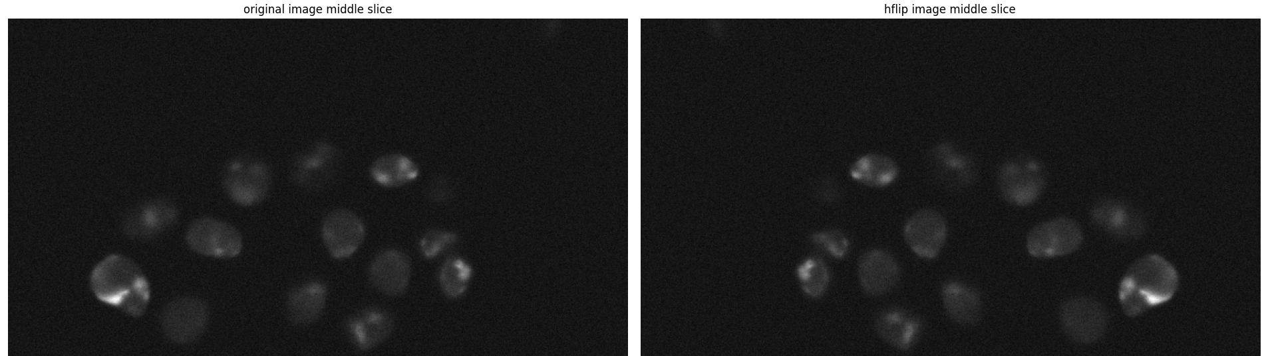
27/6/2024
Testing the augmentations

Slide 2
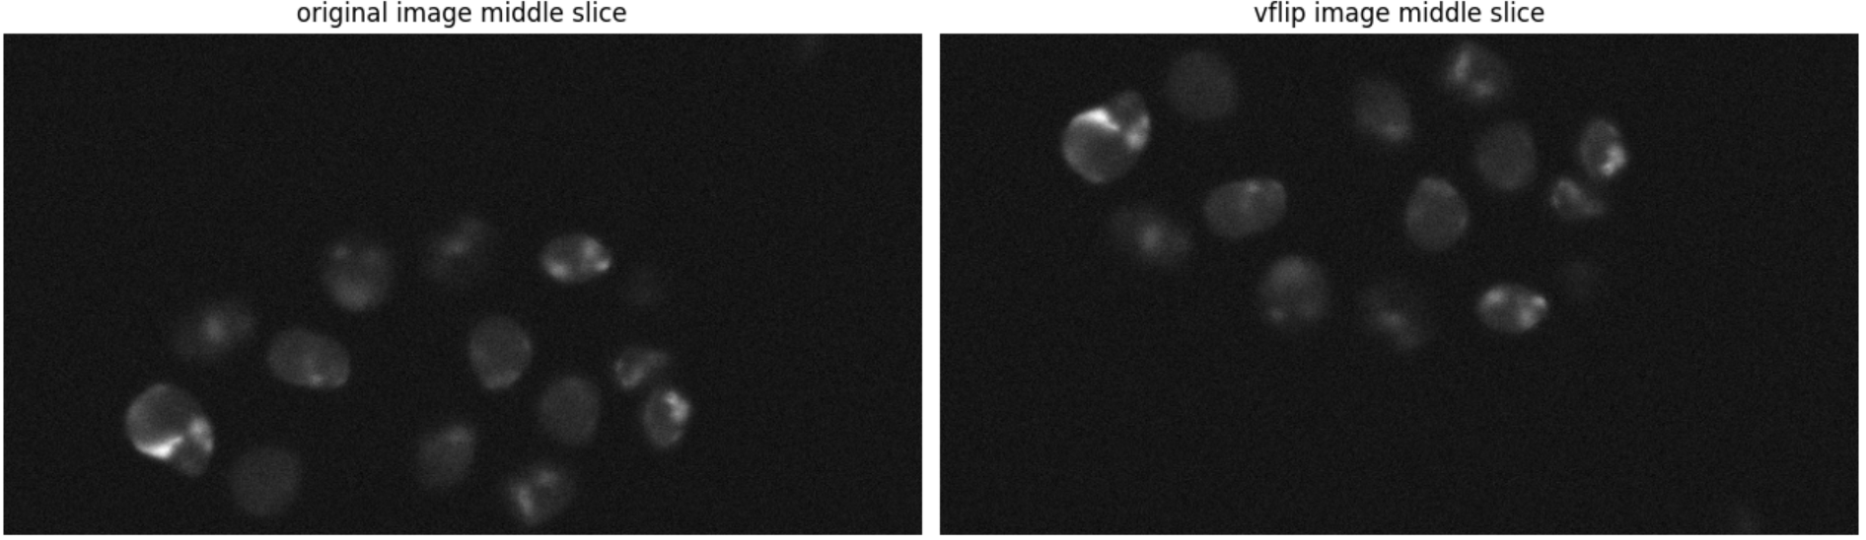
27/6/2024
Testing the augmentations

Slide 3
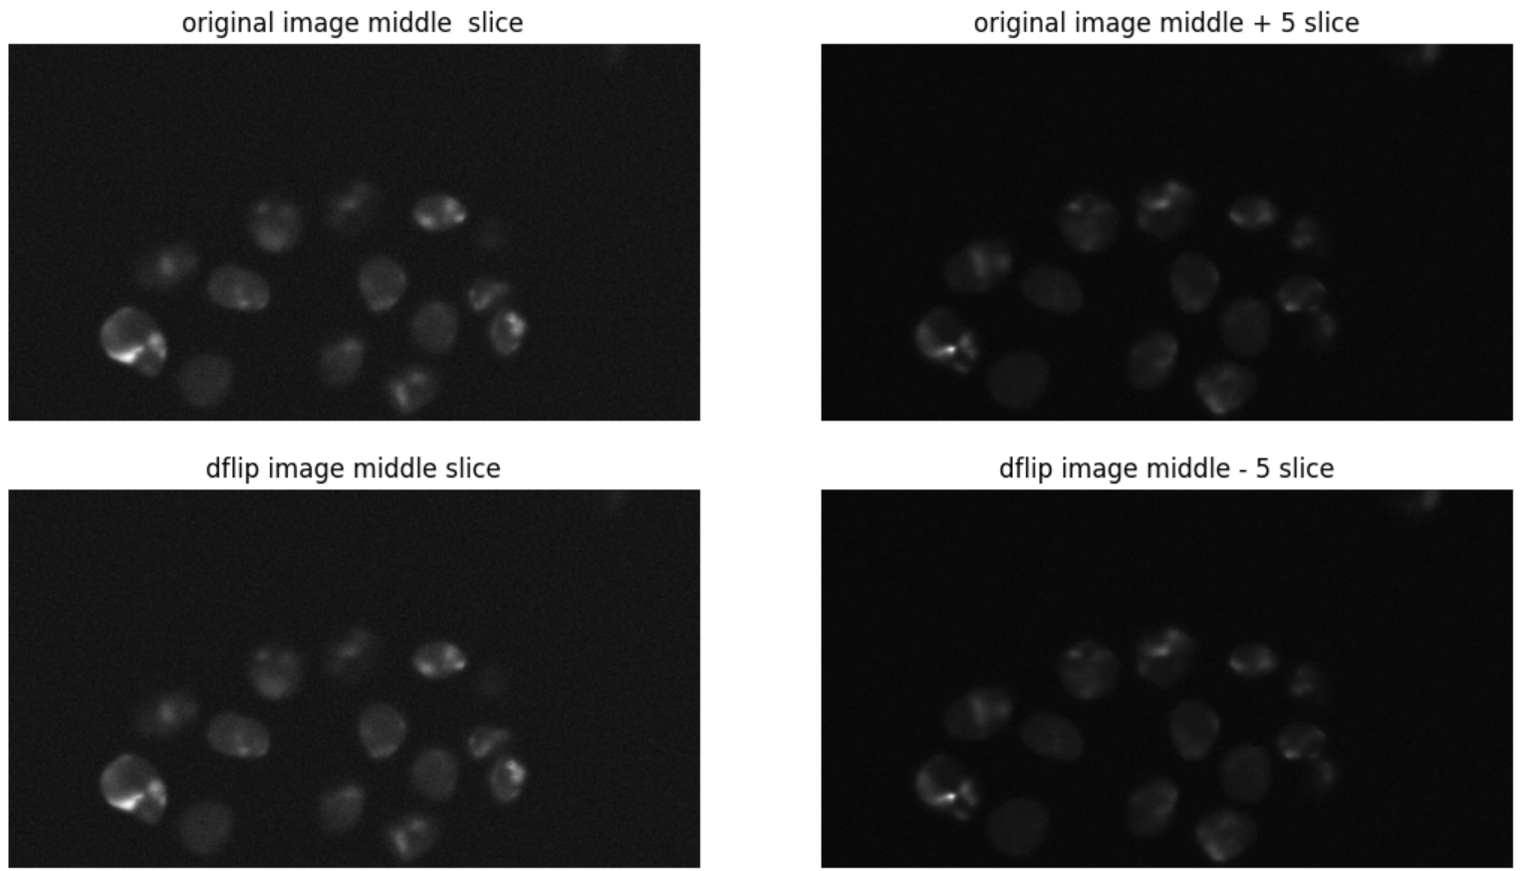
27/6/2024
Testing the augmentations

Slide 4
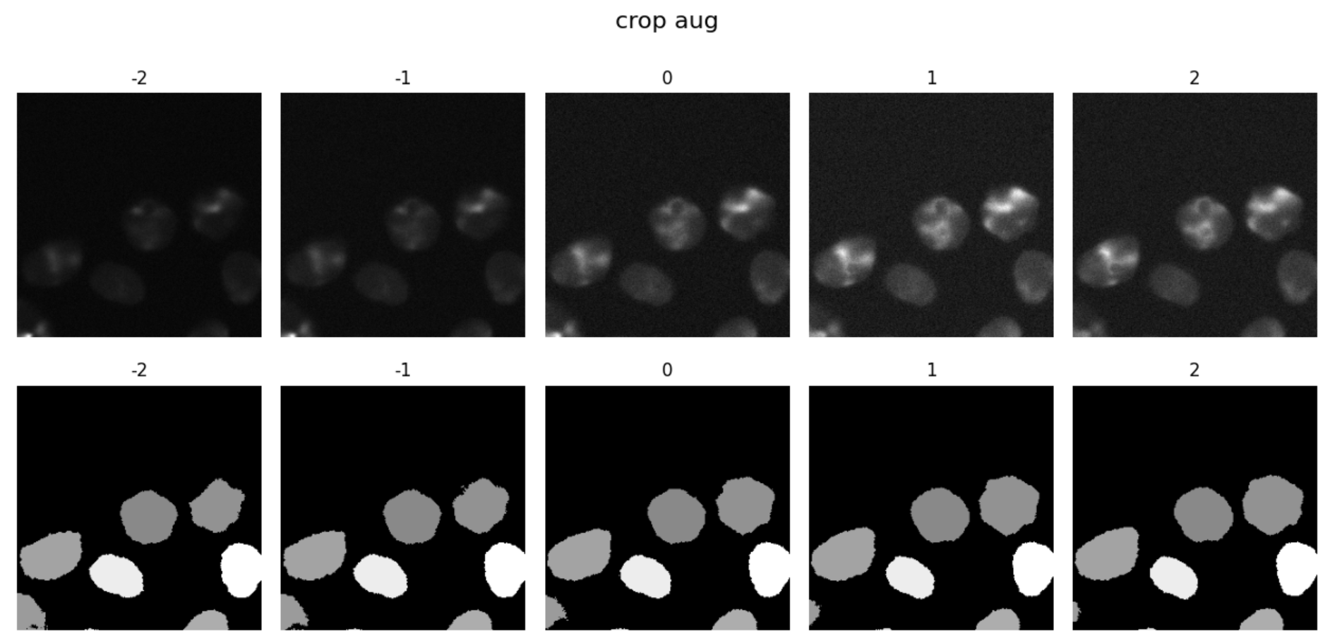
27/6/2024
Testing the augmentations

Slide 5
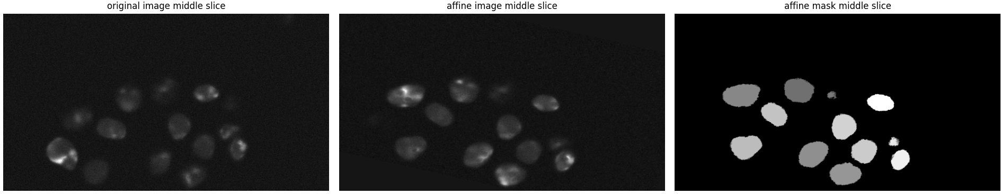
27/6/2024
Testing the augmentations

Slide 6
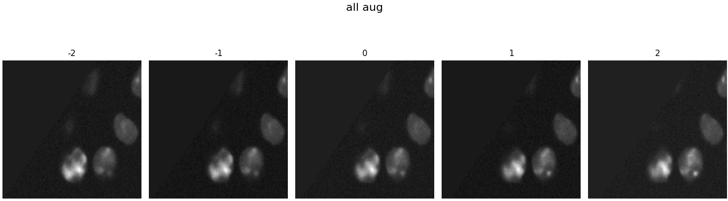
27/6/2024
Testing the augmentations

Slide 7
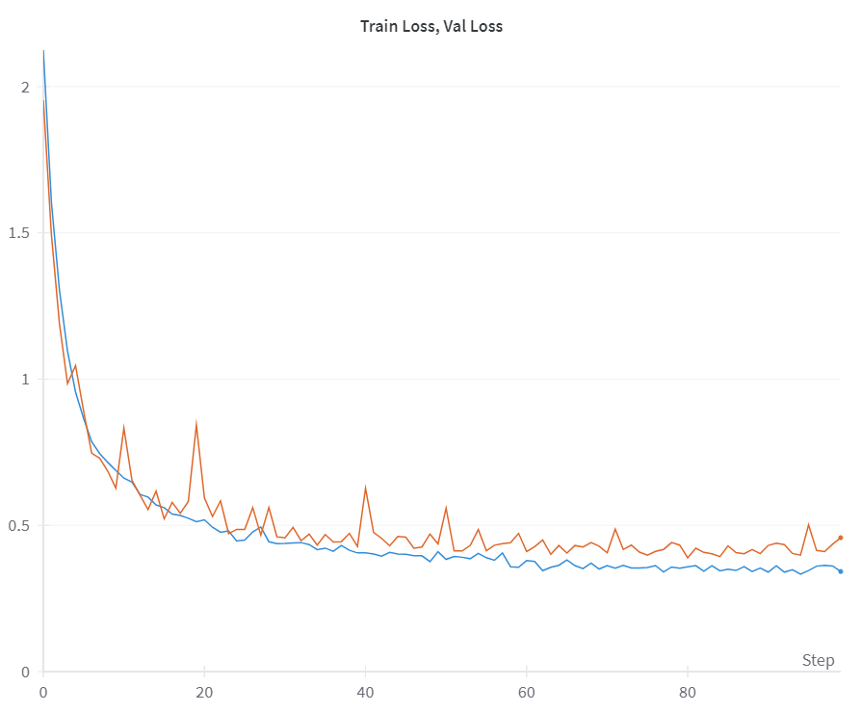
28/7/2024
3d-unet without markers, CE

Slide 8
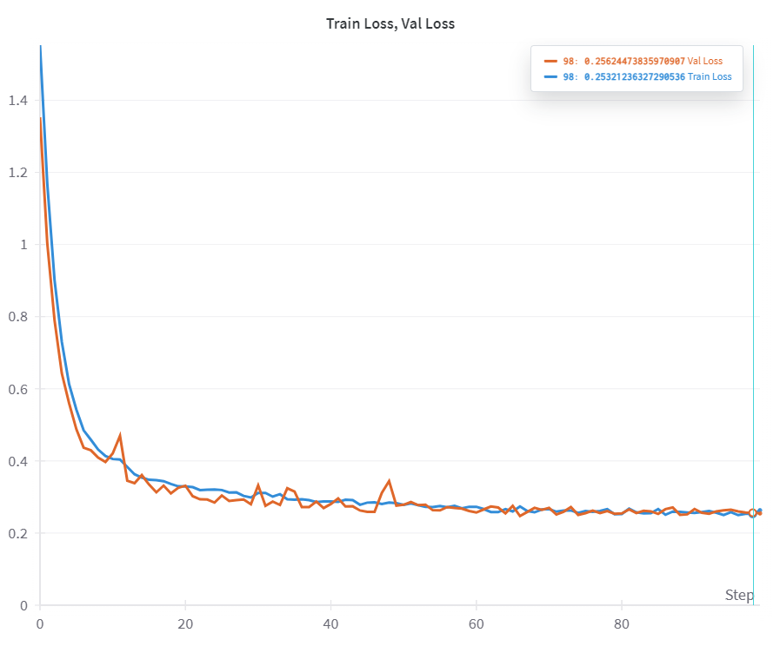
28/7/2024
3d-unet without markers, DICE-CE

Slide 9
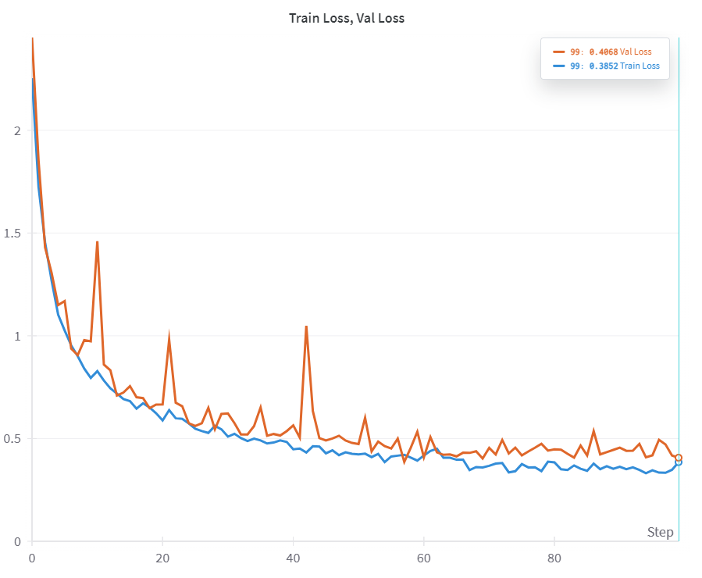
29/7/2024
3d-unet with markers, CE

Slide 10
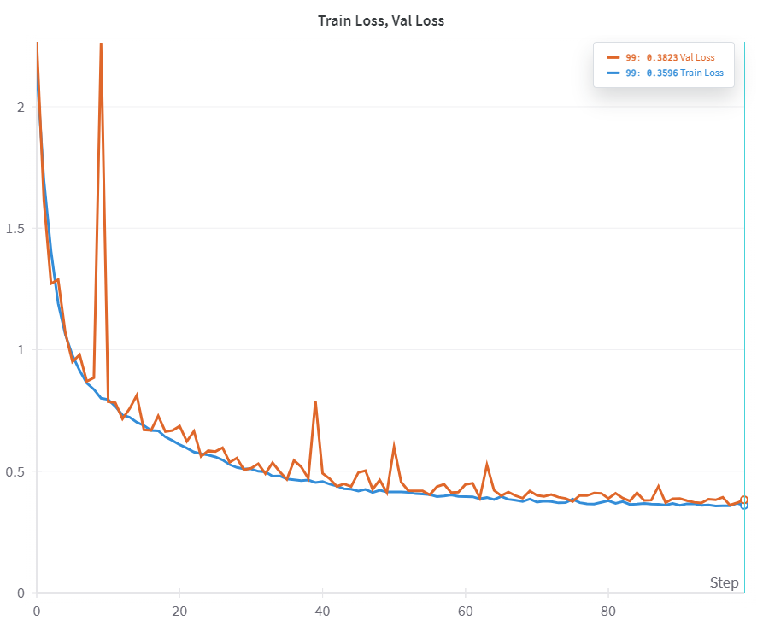
29/7/2024
3d-unet with markers, DICE-CE

Slide 11
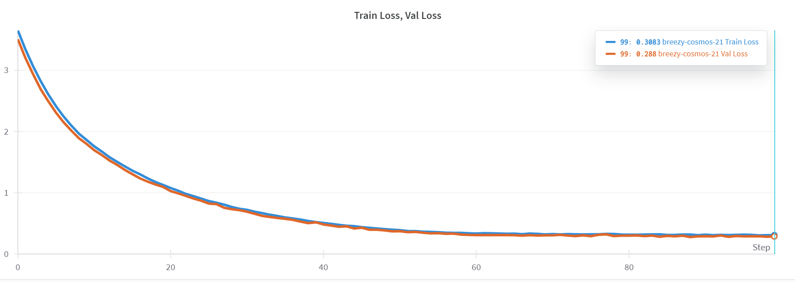
3/8/2024
VIT_UNET WITHOUT MARKERS
Notes:
Run 21 in wandb

Slide 12
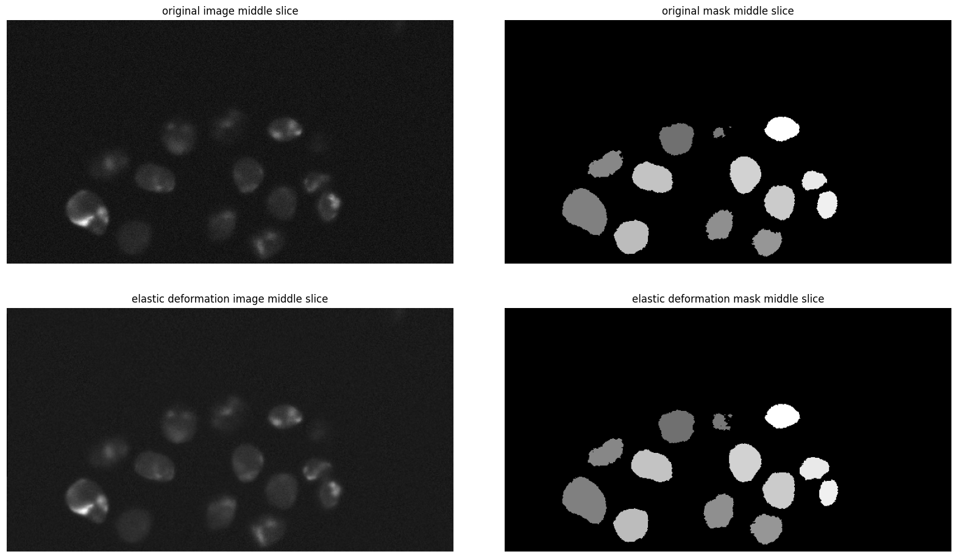
10/8/2024
Testing the augmentations

Slide 13
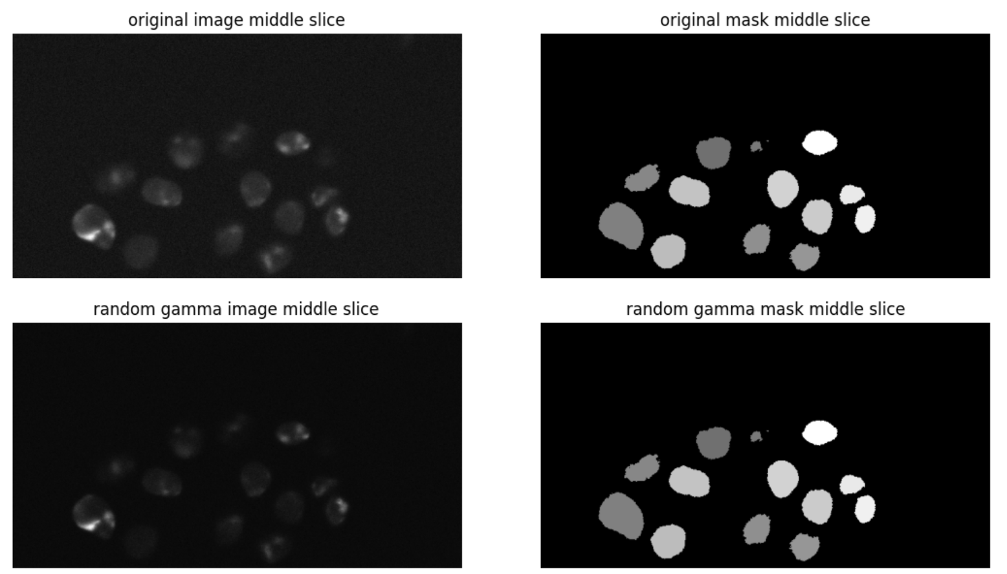
10/8/2024
Testing the augmentations

Slide 14
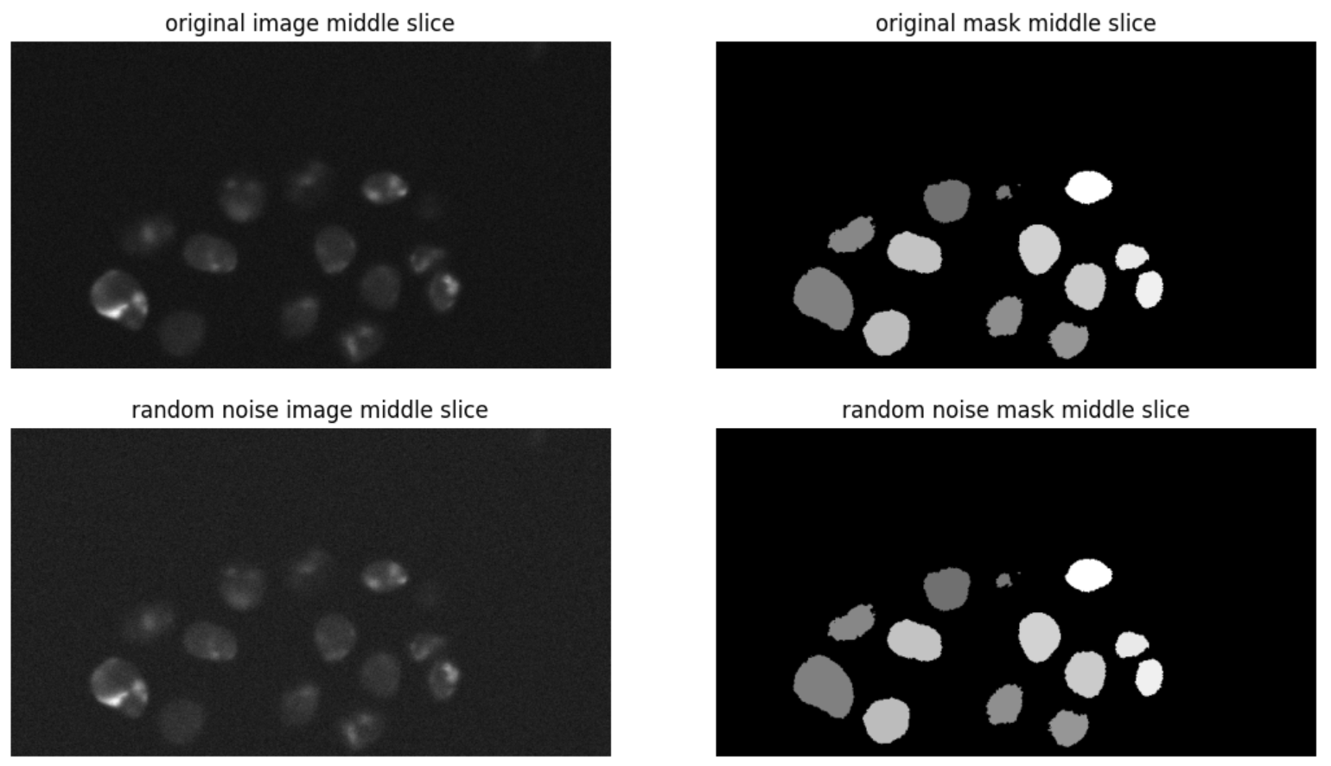
10/8/2024
Testing the augmentations

Slide 15
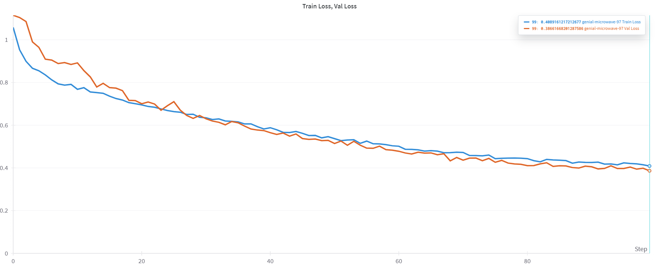
10/8/2024
VIT_UNET WITH MARKERS

Slide 16
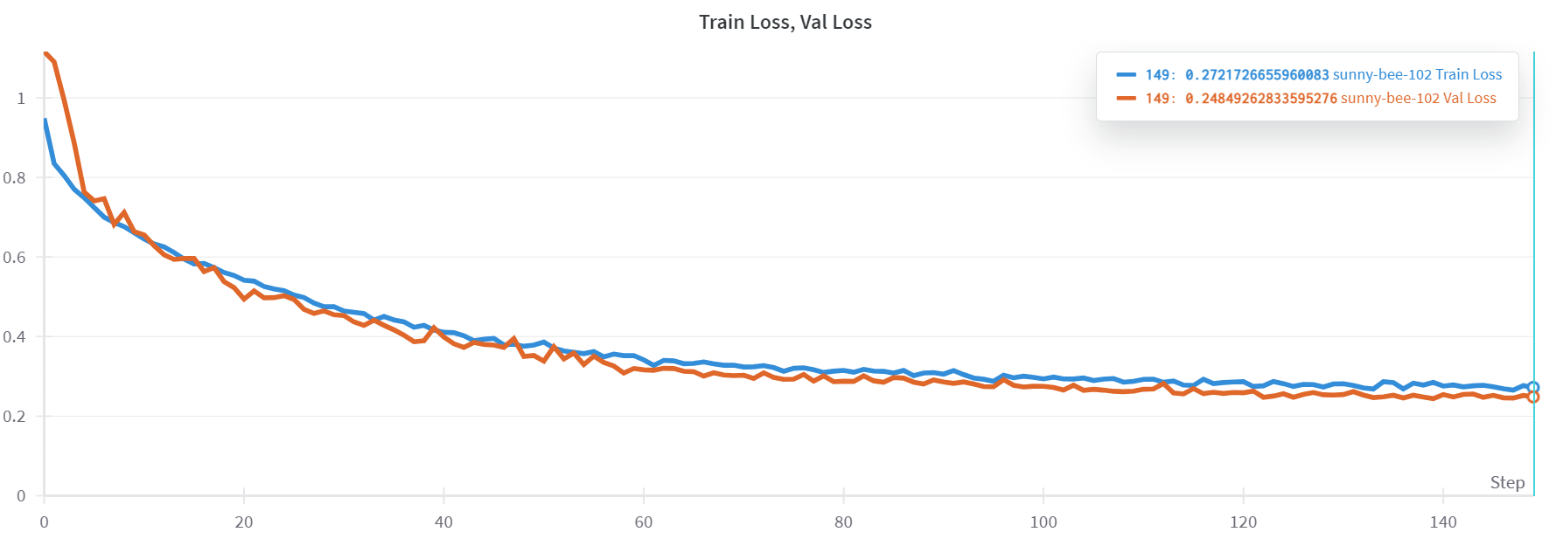
11/8/2024
VIT_UNET WITH MARKERS

Slide 17
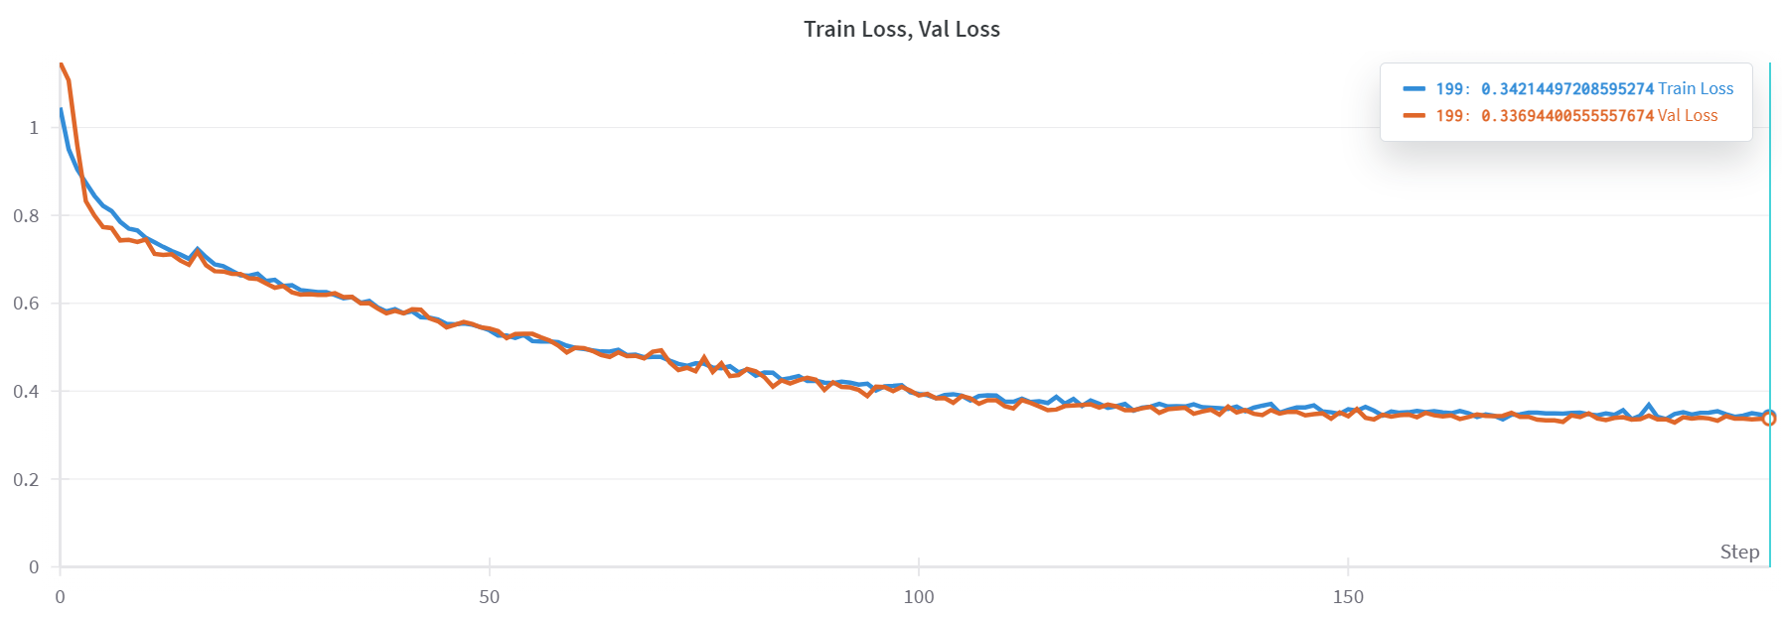
12/8/2024
SWIN_UNET WITH MARKERS
Notes:
run4

Slide 18
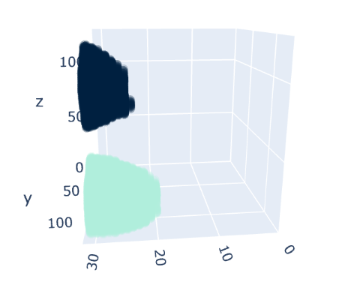
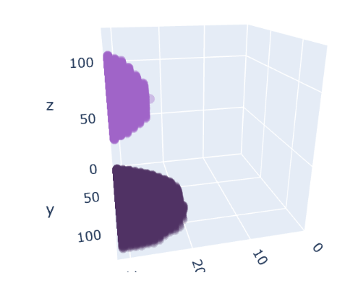
12/8/2024
SWIN_UNET WITH MARKERS
Notes:
run4

Slide 19
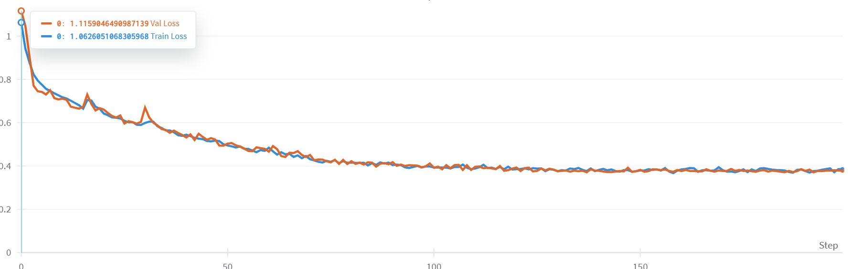
12/8/2024
SWIN_UNET WITH MARKERS
Notes:
run5

Slide 20
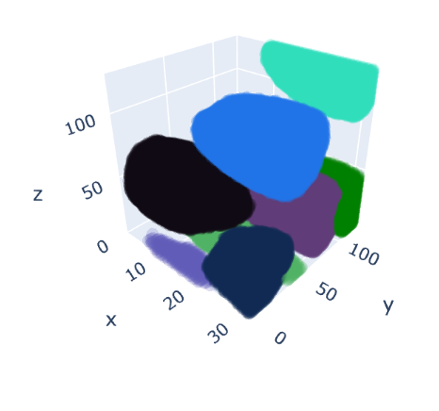
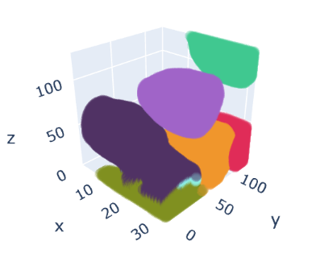
12/8/2024
SWIN_UNET WITH MARKERS
Notes:
run5

